Slide 1

Beyond the Hyperscalers
The New Era of Specialized and Sovereign Clouds

Slide 2
What are Sovereign and Specialized Clouds
A Sovereign cloud is a cloud computing environment designed so that data, infrastructure, and operations are under the legal, regulatory, and operational control of a specific jurisdiction.
Data Residency & Jurisdiction | Legal & Regulatory Compliance: | Operational Control | Strong Security & Transparency:
A Specialized cloud (vertical cloud) is a cloud service environment tailored to meet the specific functional, regulatory, operational, and security requirements of a particular industry or sector (e.g. healthcare, finance, public sector, manufacturing).
Industry-specific compliance & regulation | Tailored functionality and workflows | Security, privacy, and operational diligence | Optimized for business processes

Slide 3
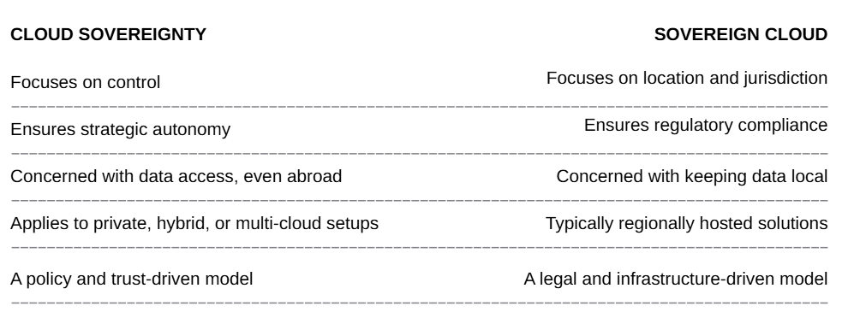
Sovereignty not quite same as Sovereign!
Cloud sovereignty refers to an organization’s ability to retain full control over its data, services, and infrastructure—no matter where the cloud is hosted.
“Who controls the data privacy?”
A Sovereign cloud, on the other hand, refers to cloud services that are physically and legally confined within a nation’s or region’s jurisdiction.
“Where is the data and whose laws apply?”

Slide 4
Digital Sovereignty
Digital Sovereignty
Data
Sovereignty
Technological Sovereignty

Slide 5
Context and Concerns
Reliance on Foreign providers
Risk of Foreign Legal Overreach: CLOUD Act & FISA §702 Forcing Access to European‑Stored Data
Foreign Infrastructure Dependence Creates Chokepoints for Public and Critical Services
Its not just about data residency but also metadata residency!!!
165 nations have data protection laws so clearly, we need specializations…

Slide 6


Slide 7


Slide 8
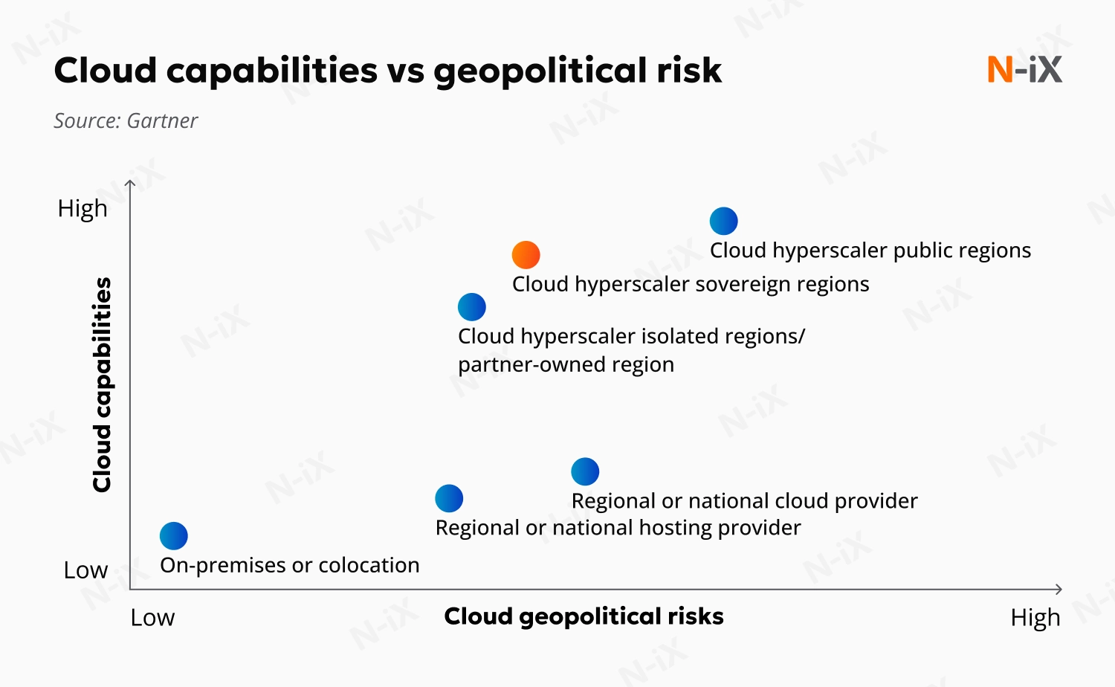
Taking the point home… statistically!
Source: https://www.n-ix.com/sovereign-cloud/

Slide 9
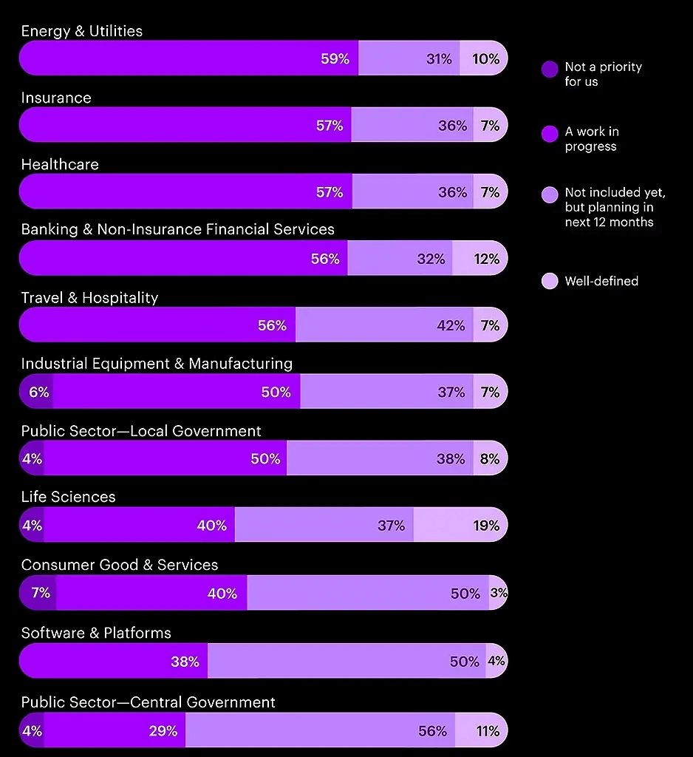
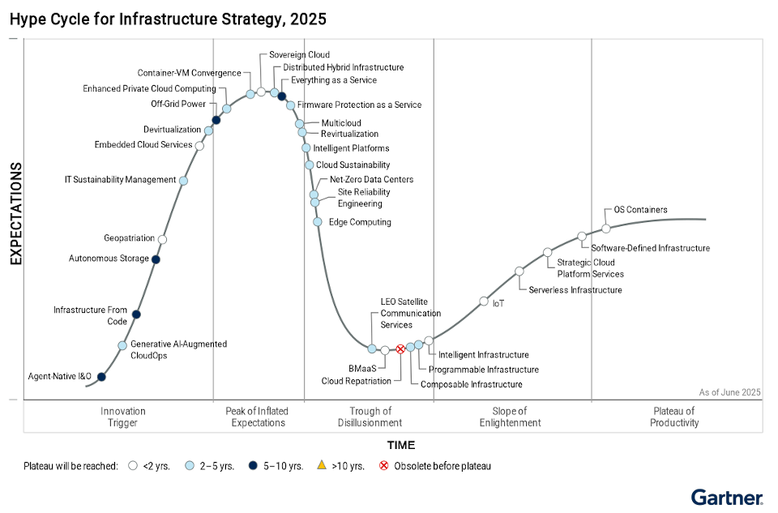
Is this even talked about?
Source: Accenture Sovereign Cloud Survey in Europe

Slide 10
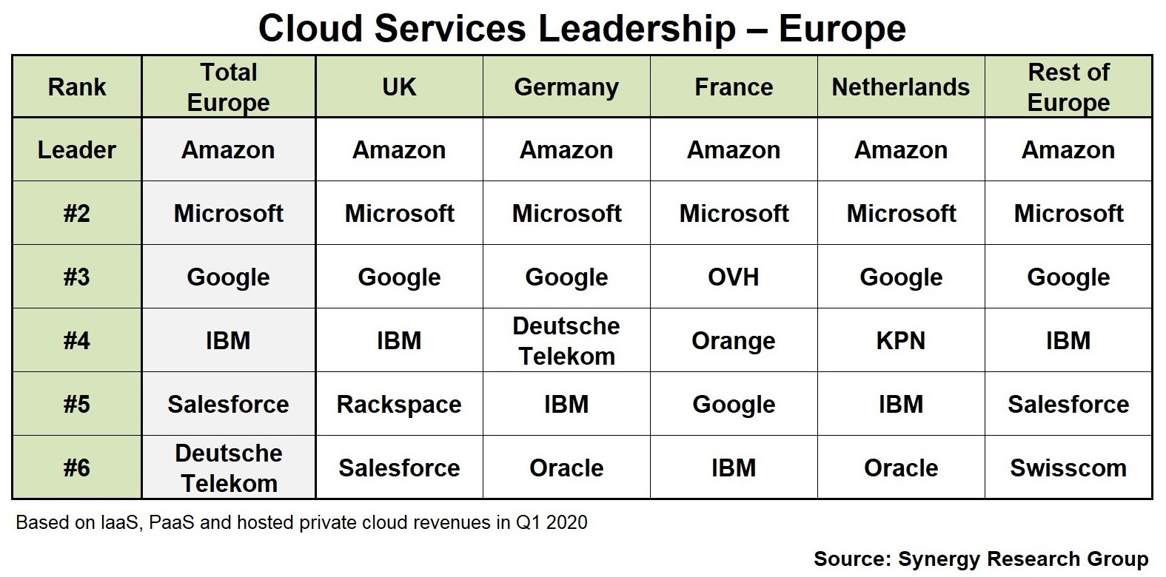
Current Situation

Slide 11
What does it take to get one?
True Cloud Sovereignty Is Developed,
Not Acquired
Data Residency
National Legal Jurisdiction
Locally Owned Infrastructure
Independent Operations
Secure Software Stack
End-to-End Encryption
Regulatory Compliance
Cybersecurity Governance
Local Cloud Ecosystem

Slide 12
What would an organization need it?
Internal drivers
External drivers
Organizational goals
EU Regulations
Organizations sector
(strategic, defence or intelligence…)
Geopolitical reasons
Specialized services
…
Fear of sabotage or isolation

Slide 13
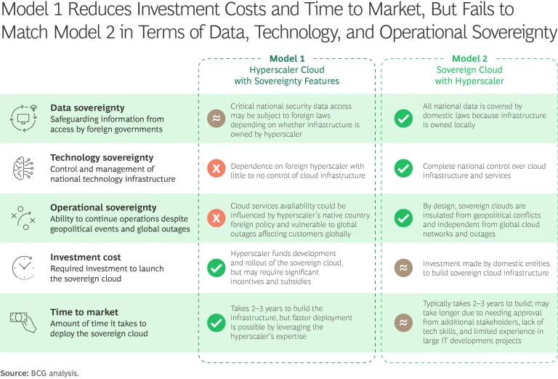
Frameworks or Models
Source: https://www.bcg.com/publications/2025/sovereign-clouds-reshaping-national-data-security

Slide 14
Frameworks or Models
Category | EU Cloud Providers (e.g., Cleura) | Non-EU Cloud Providers (Hyperscalers)
Data Sovereignty | All data stored and processed within the EU | Data may be stored across global regions
Legal Jurisdiction | Fully under EU laws (GDPR, NIS2, Schrems II) | Subject to U.S. laws (e.g., CLOUD Act)
Compliance | GDPR, ISO 27001, ISO 27017, ISO 27018, C5 | Requires complex agreements for EU alignment
Data Transfer Risk | No cross-border transfer risks | Transatlantic transfer risks, legal exposure
Transparency | OpenStack APIs, clear billing, open standards | Opaque pricing, proprietary platforms
Vendor Lock-In | Avoided with open APIs and compatibility | High switching costs and complexity
Support & Responsiveness | Local EU-based teams, fast SLA response | Global queues, potentially delayed EU support
Ideal For | Regulated industries, governments, EU-based orgs | Large-scale global workloads
Source: https://www.bcg.com/publications/2025/sovereign-clouds-reshaping-national-data-security

Slide 15


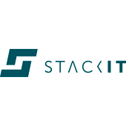

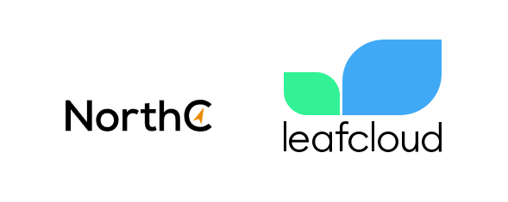

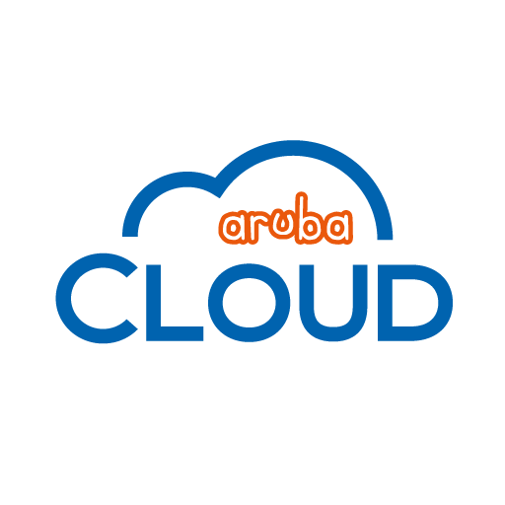
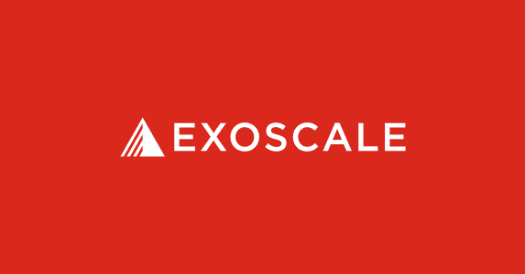


Alternatives

Slide 16
Focused on data sovereignty, regulatory compliance, and vendor neutrality.

Slide 17
Cleura is a European Cloud provider that offers a robust Infrastructure-as-a-Service (IaaS).
The platform is built on OpenStack.

Slide 18
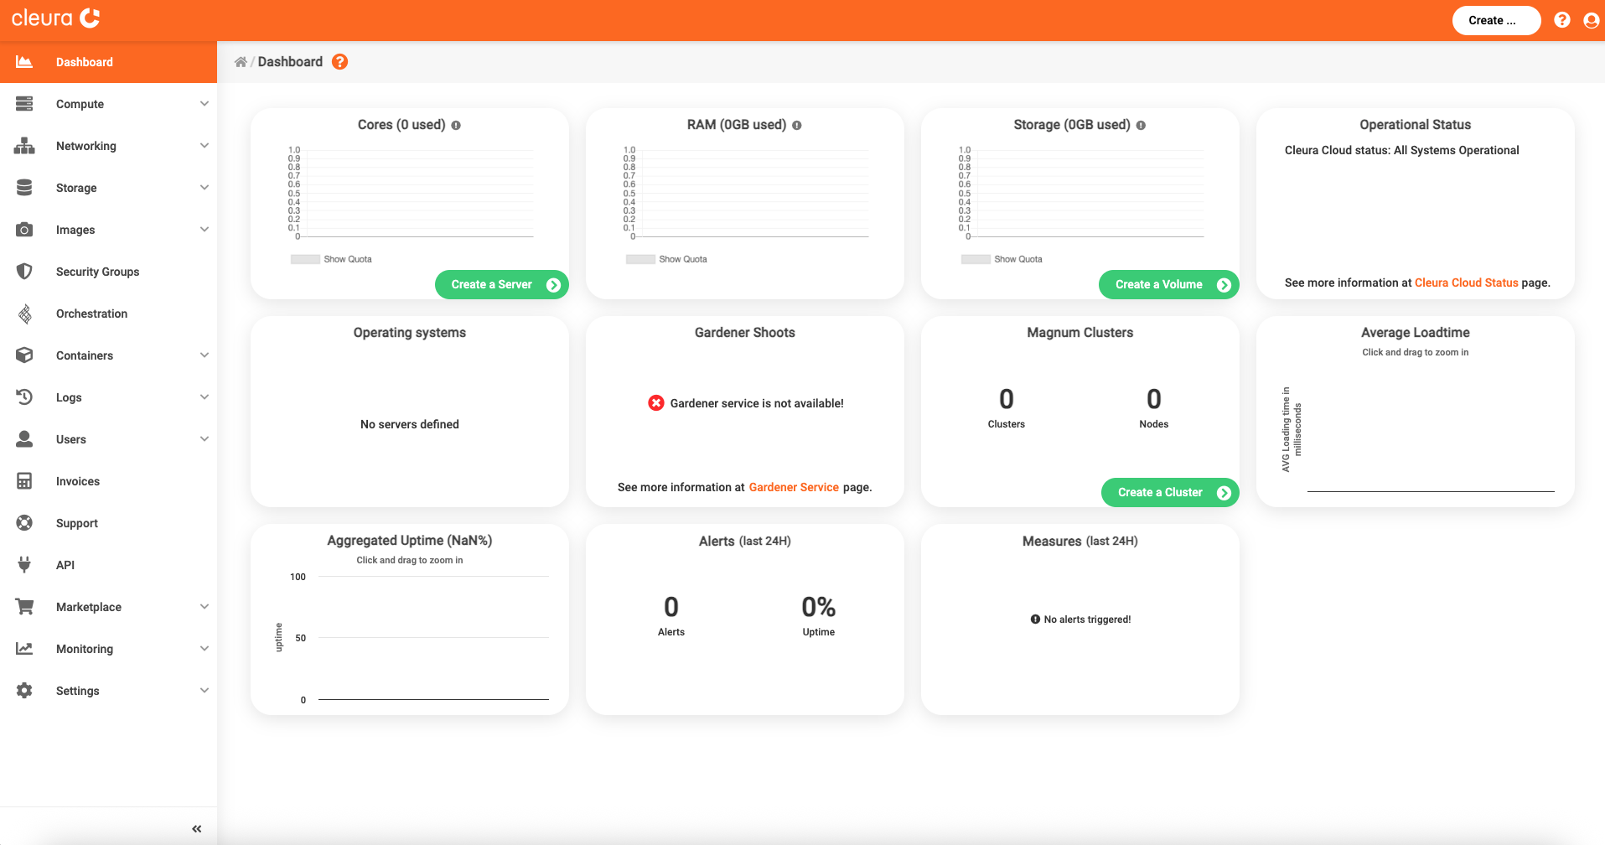
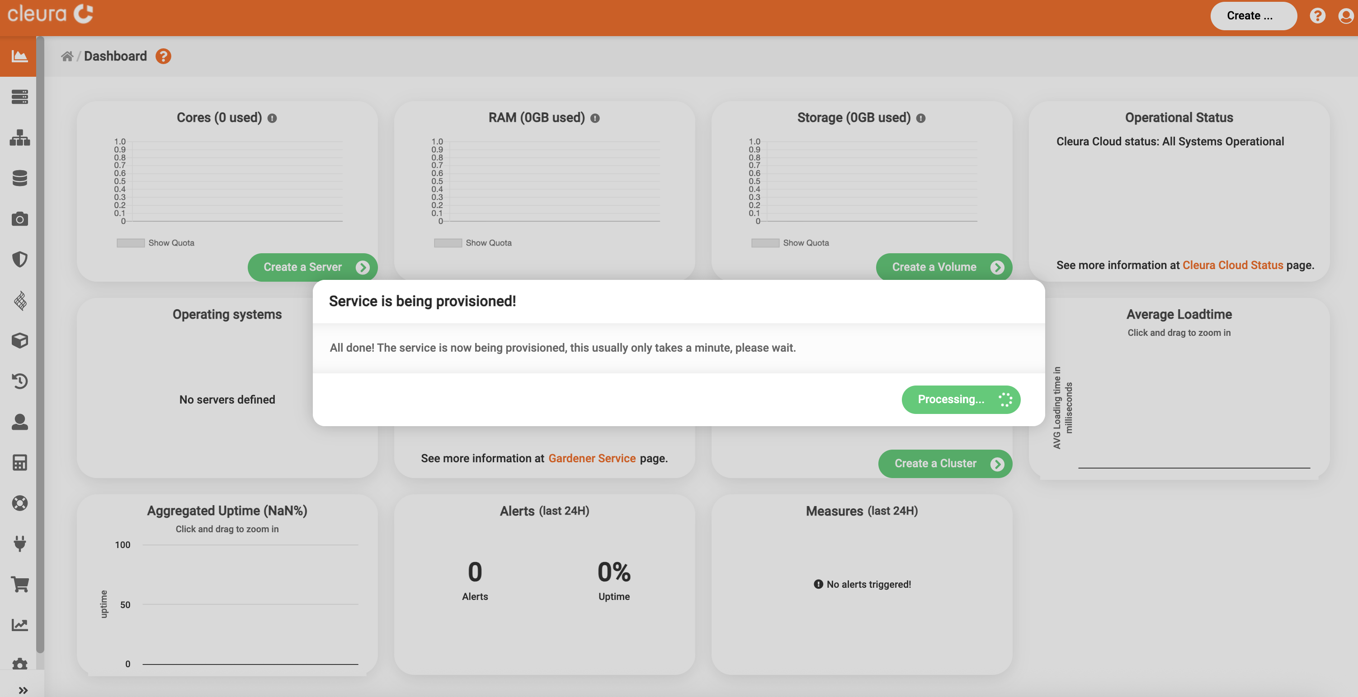

Slide 19
OVHcloud, a French company with a global presence and Europe's leading cloud provider, offers public and private cloud, hosting, dedicated servers, domain registration, telephony, and internet services in 140 countries.
The platform is built on OpenStack.

Slide 20
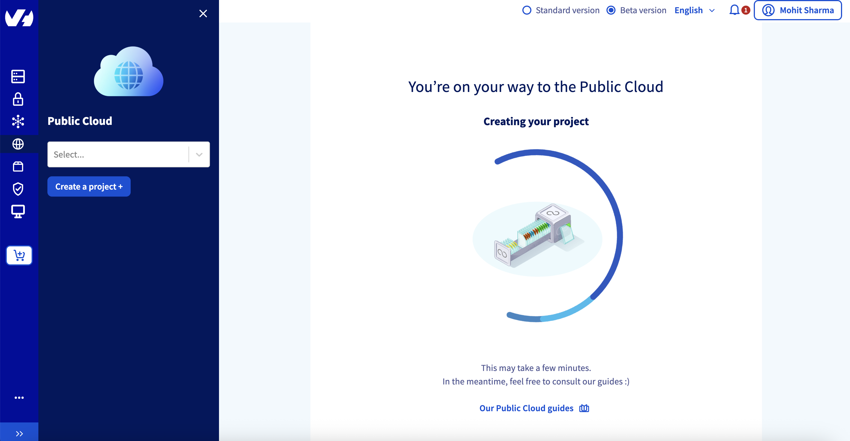

Slide 21
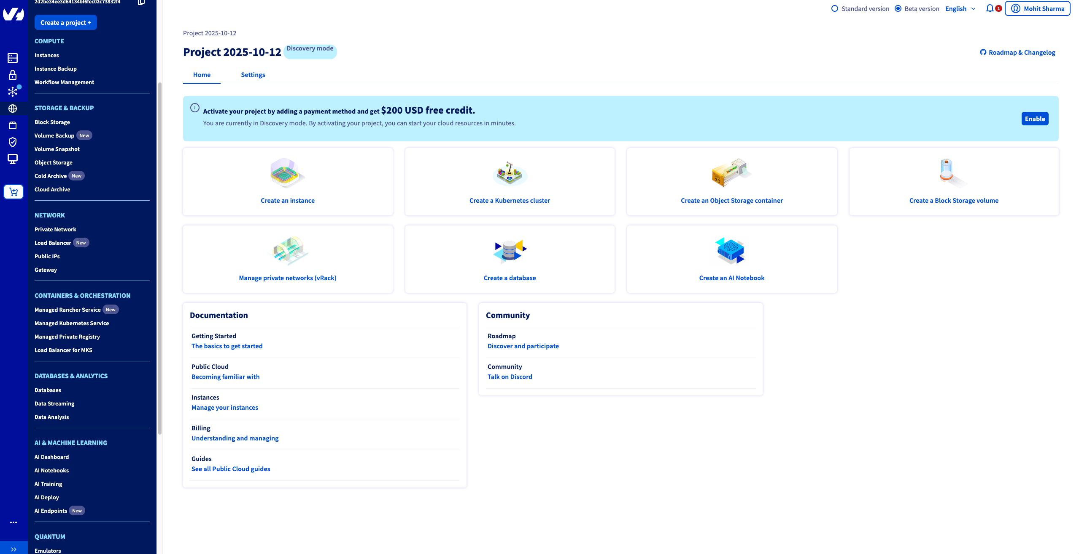

Slide 22
Offers a robust Infrastructure-as-a-Service (IaaS). It is set apart due to its sustainable approach and carbon footprint tracking.
The platform is built on OpenStack.

Slide 23
MediTuner: Digital Health Compliance
Boost.ai – AI with Regional Compliance
Needed a secure platform to handle sensitive healthcare data under strict EU laws.
Cleura Fit:
Hosted AI models close to end-users for low latency
Ensured customer data stays in the EU
Integrated OpenStack APIs for automation at scale
Enabled multi-cloud deployments with compliance
Expanding across Europe while meeting local data regulations.
Cleura Fit:
Hosted AI models close to end-users for low latency
Ensured customer data stays in the EU
Integrated OpenStack APIs for automation at scale
Enabled multi-cloud deployments with compliance

Slide 24
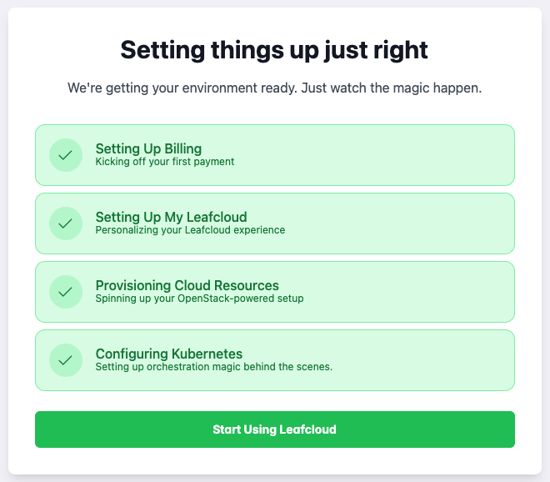
Focused on data sovereignty, regulatory compliance, and vendor neutrality.
Cleura offers a robust Infrastructure-as-a-Service (IaaS) platform built on OpenStack.
Web Access: https://my.leaf.cloud/

Slide 25
UpCloud founded in 2011 and headquartered in Helsinki, Finland, it offers scalable cloud solutions to businesses globally, supported by an international team. offers a robust Infrastructure-as-a-Service (IaaS)
Built on a proprietary platform

Slide 26
MediTuner: Digital Health Compliance
Boost.ai – AI with Regional Compliance
Needed a secure platform to handle sensitive healthcare data under strict EU laws.
Cleura Fit:
Hosted AI models close to end-users for low latency
Ensured customer data stays in the EU
Integrated OpenStack APIs for automation at scale
Enabled multi-cloud deployments with compliance
Expanding across Europe while meeting local data regulations.
Cleura Fit:
Hosted AI models close to end-users for low latency
Ensured customer data stays in the EU
Integrated OpenStack APIs for automation at scale
Enabled multi-cloud deployments with compliance

Slide 27
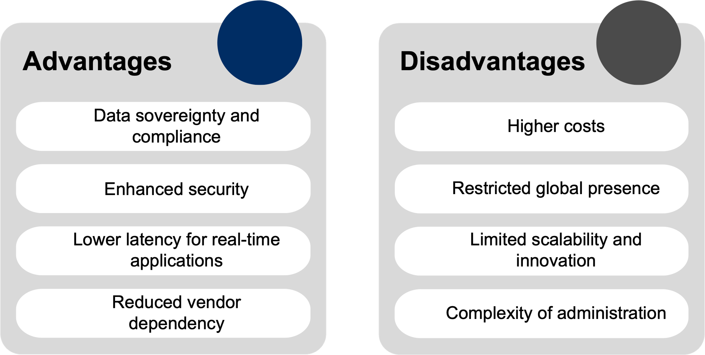
Advantages and (Potential) Disadvantages

Slide 28
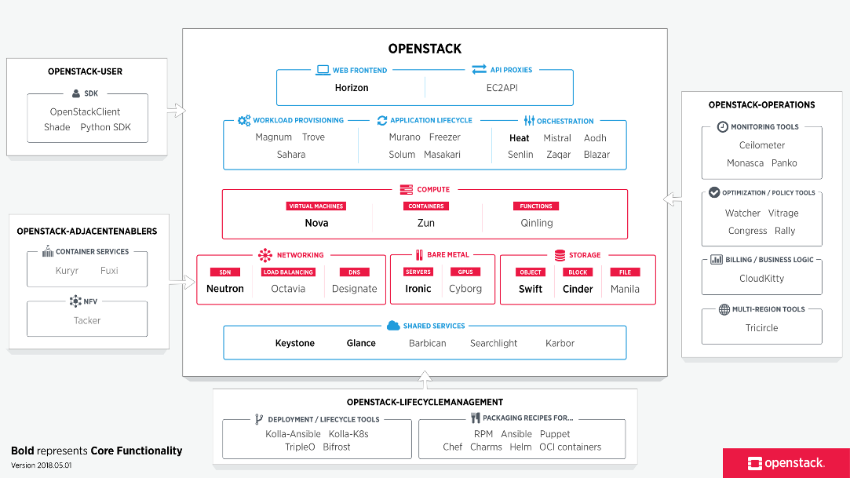

Slide 29
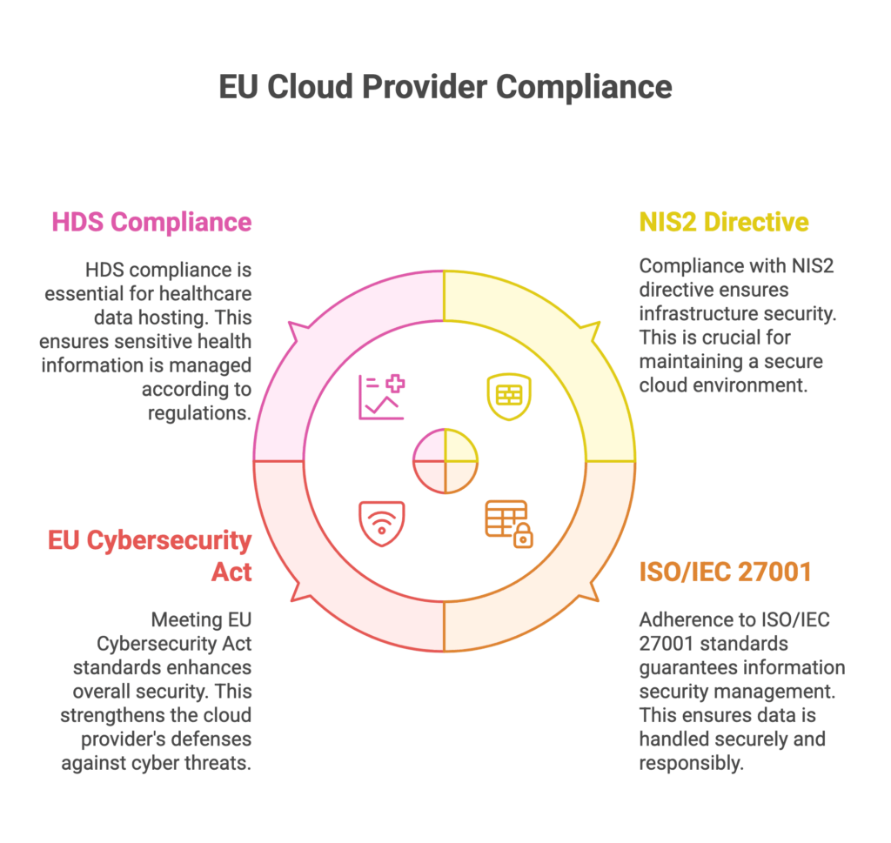
Challenges & Limitations

Slide 30
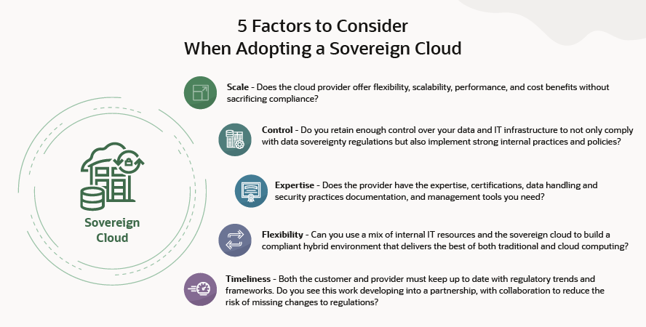

Slide 31

Cleura Cloud voucher code: "MOHITNIC"
-€500 worth of Cleura Public Cloud resources (licenses excluded)
-Usable for 60 days from activation
-The voucher expires on 2026-01-03.

Slide 32
Further Reading / Resources
The Digital Services Act and the Digital Markets Act
Who really owns your data? Comparing European sovereign cloud providers
https://www.eucloud.tech/eu-providers/cloud
https://european-alternatives.eu/category/cloud-computing-platforms
https://www.provirtualzone.com/cleura-cloud-a-european-cloud-alternative/

Slide 33
Further Reading / Resources
https://upcloud.com/
https://cloud.ionos.com/compute/sign-up
https://www.ovhcloud.com/en/public-cloud/free-trial/
https://leaf.cloud/
https://www.ovhcloud.com/en/public-cloud/free-trial/
https://jottacloud.com/en/pricing?category=jottacloud-personal

Slide 34
Challenges & Limitations
High Complexity in Designing Sovereign Cloud Infrastructure
Limited Availability of Skilled Local Talent
Dependency on Foreign Hardware and Core Technologies
Immaturity of Sovereign Cloud Platforms and Architectures
High Cost of Ownership and Lack of Economies of Scale
Processor Market: 95% US Control Intel and AMD
Operating System: Linux and Windows both US based
Cisco dominates with 76.89% global market share
…….

Slide 35
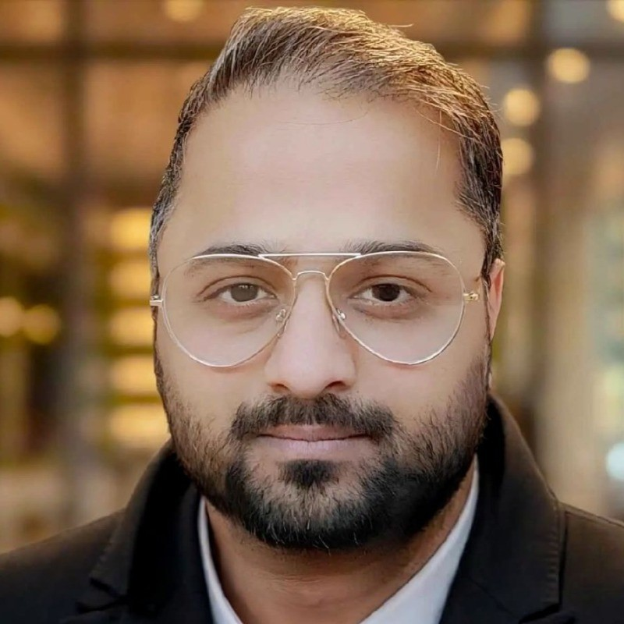

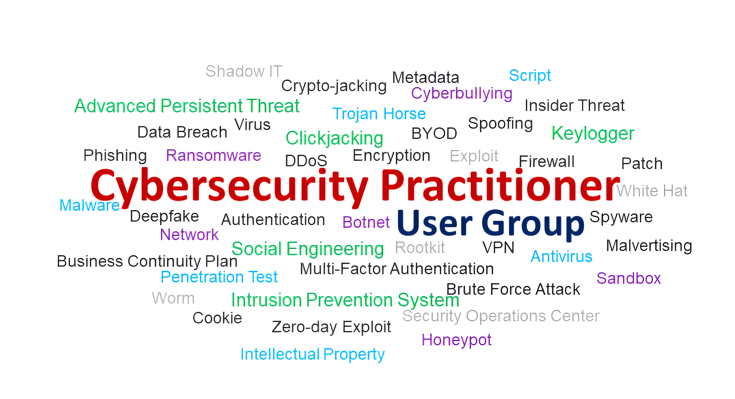
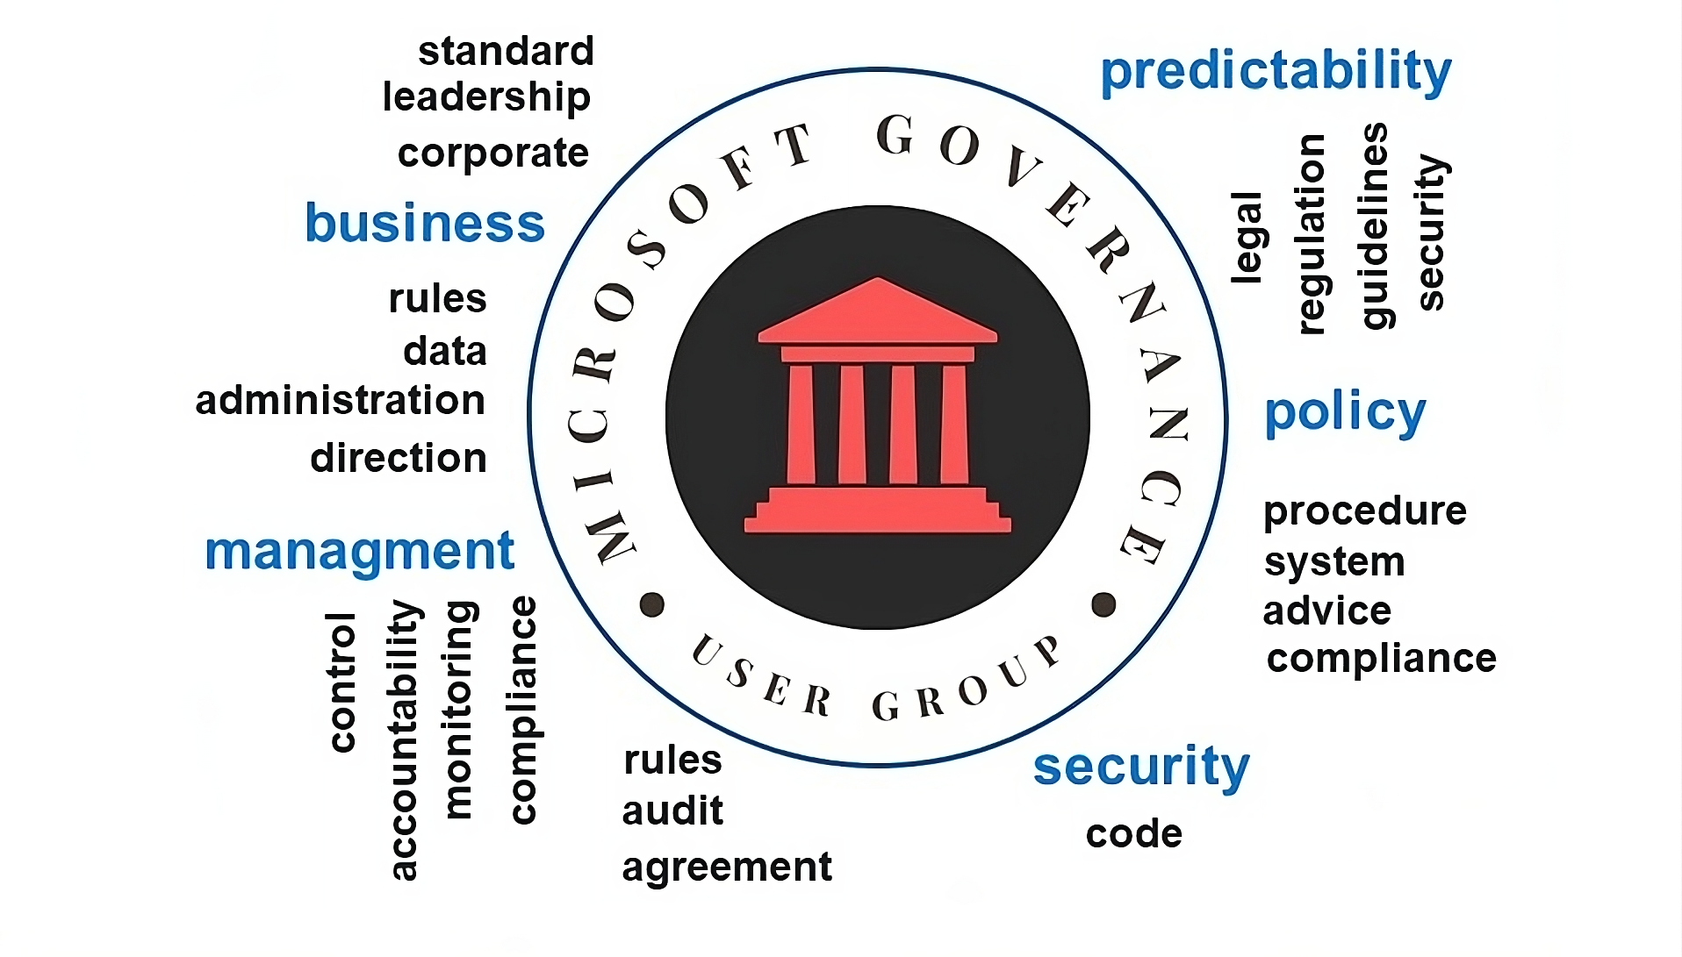
Mohit Sharma
Website: https://mohit13.com/
Masters in Entrepreneurship and Innovation Management
Masters in Information Technology
Master in Robotics and Control

